Slide 1
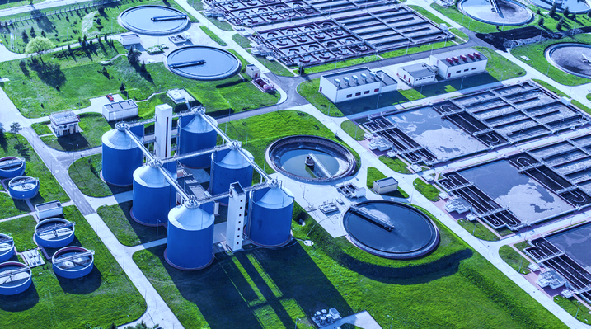

Advanced Data Analytics for Sewage Processing Stations
Matthew Fyfe 1/8/2021

Slide 2
Contents
3, 4 & 5 – Observations on the Data
6 – Making Decisions
7 – Associated Costs
8 – Additional Variables to Consider
9 – Digital Twin Modeling
10 – Analysis Types for Actionable Insight

Slide 3
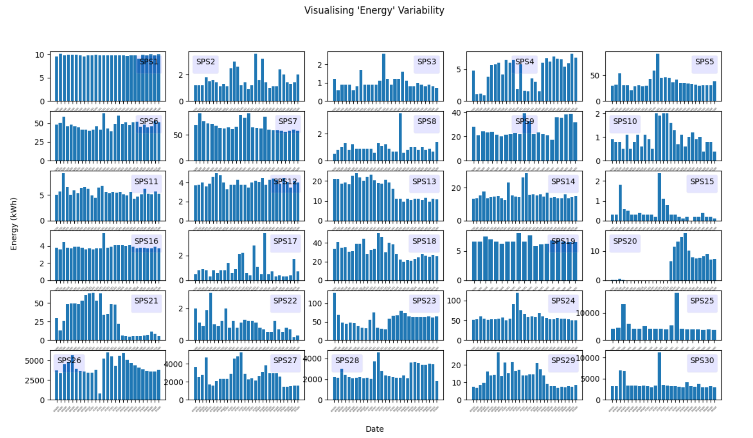
Observations on the Data
Several missing instances were detected, and a number of instances were removed due to missing ‘Energy’ values which could not be synthesised.
For many of the stations, high variability and a significant number of outliers were detected, in the ‘Energy’ data. The variability indicates a lot of room for optimisation, which could lead to cost savings, but may be due to data quality in part.

Slide 4
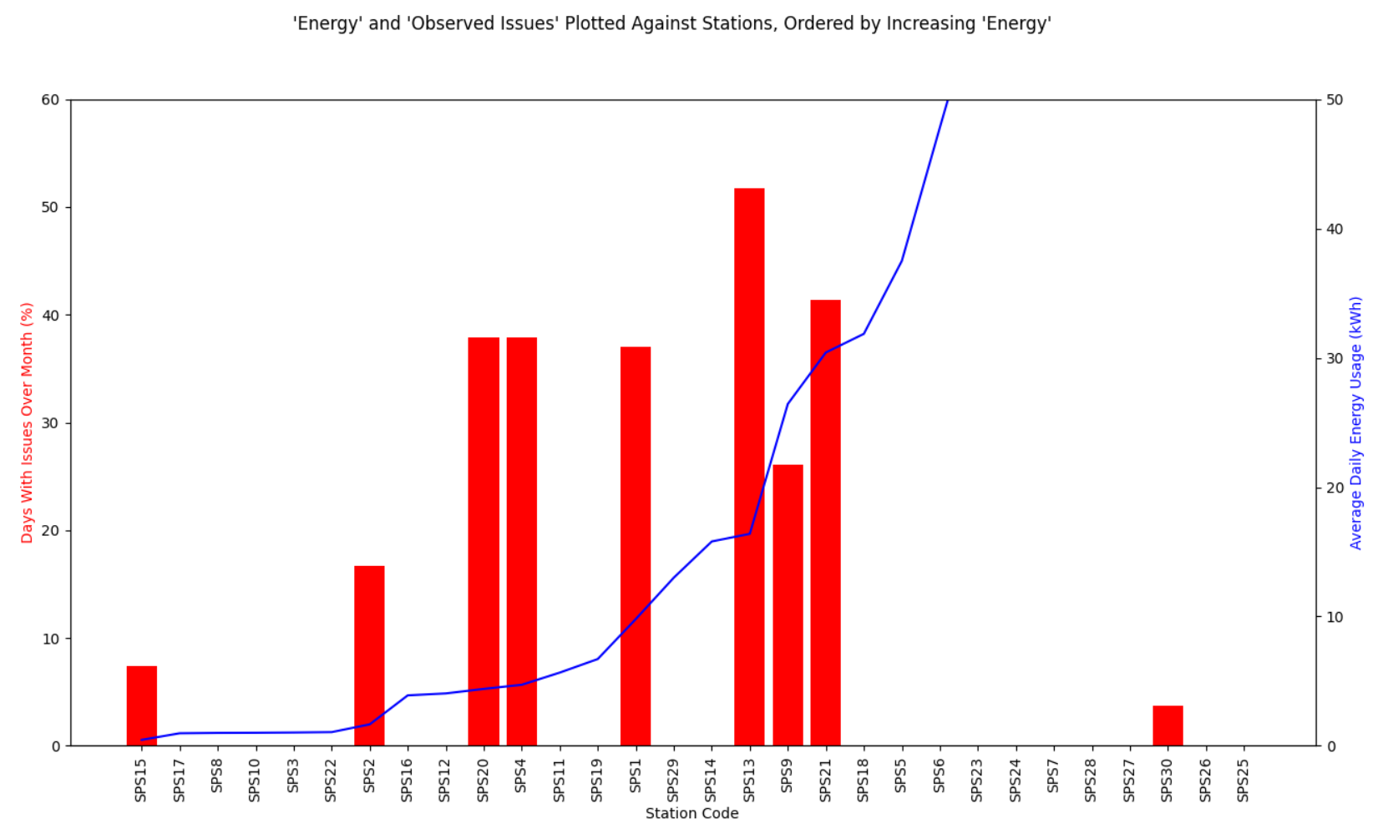
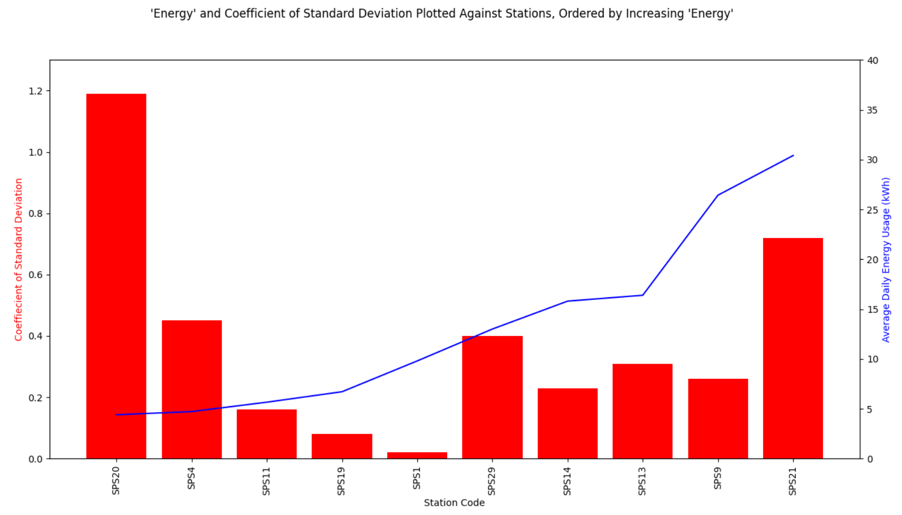
Observations on the Data
The data shows a far higher level of ‘Observed Issues’ being reported in plants where ‘Energy’ was between 4-30kWh. Only three of the plants with ‘Observed Issues’ were outside of this ‘Energy’ bandwidth and in those cases issue reports were significantly fewer. (top left)
Checking the coefficient of standard deviation in these stations didn’t help to further understand the problem. (lower right)

Slide 5
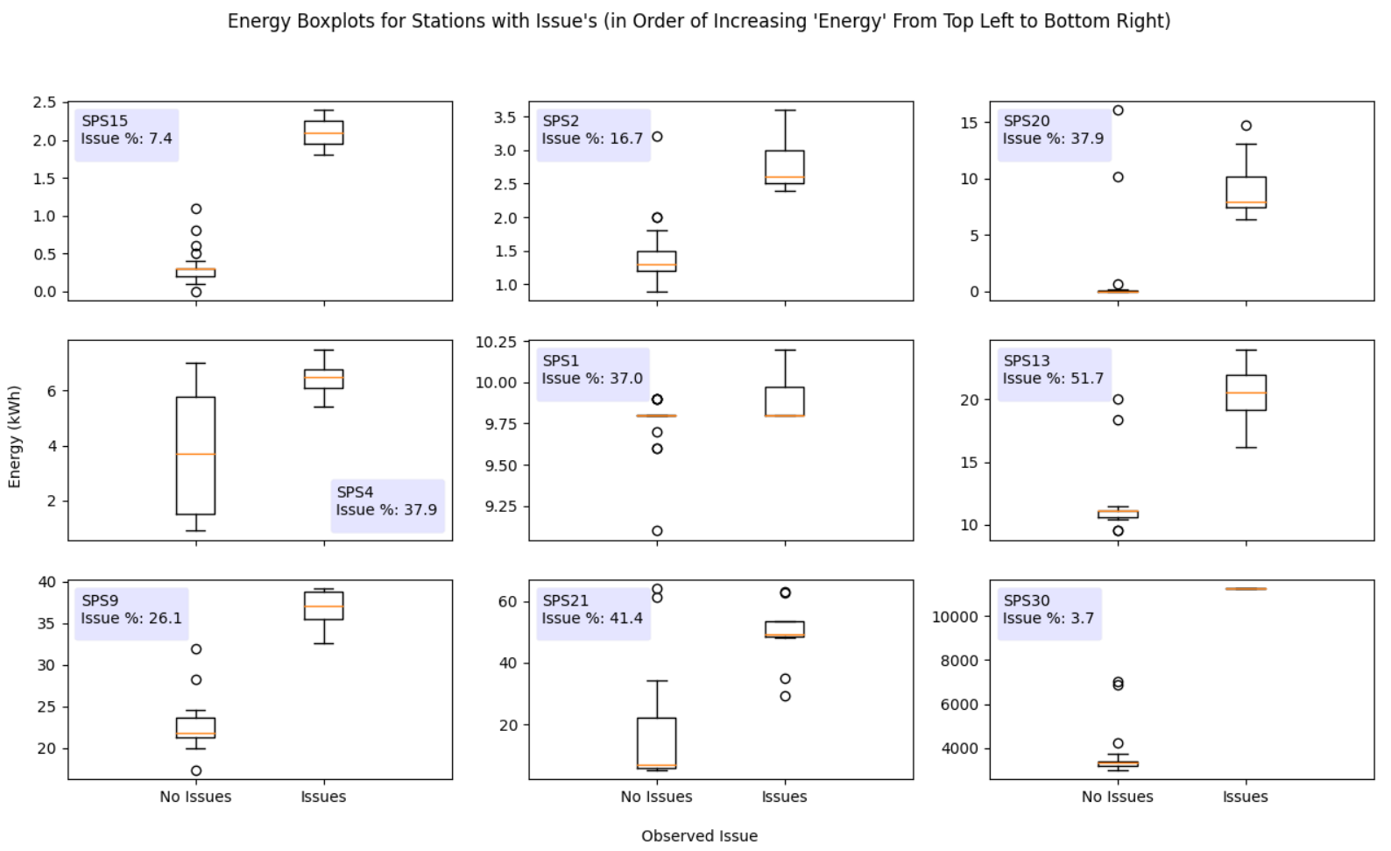
Observations on the Data
When looking at the nine plants which reported issues, over the month, individually, we can see that ‘Observed Issue’ reports are invariably associated with higher levels of ‘Energy’.
In the affected station, there are only a few outlying cases where high ‘Energy’ doesn’t relate to ‘Observed Issues’

Slide 6
Making Decisions
Leverage cost savings across facilities, by comparing station running costs to aggregated data or other stations of similar output.
Calculate pay-off periods for replacing old equipment, thereby allowing SW to prioritise equipment replacement.
Calculate equipment and machinery specifications for new stations and when replacing legacy equipment.
Optimise building layouts and material usage when planning new stations.
Find new ways to reduce costs and deal with maintenance issues pre-emptively
Find more efficient ways to design plants and machinery, through sensory data feedback on localised capacity usage.
Through the analysis applied to the dataset given, we may reach decisions on which plants to upgrade to a higher capacity. Though this is not the only conclusion we can draw, without further information.
Generally, we are looking to minimise costs when turning sewage into environmentally neutral outputs (in accordance with industry regulations).
Insights could be derived from the data to automate or allow manual decision making in several ways.
Optimise or potentially negate the need for routine maintenance
Reduce the number of issues with equipment, by predicting problems
Increase the lifespan of equipment, by reducing issues.
Reduce build costs by producing more highly optimised specifications for facility and machinery design.
Reduce time spent planning, by automating parts of the process

Slide 7
Associated costs
Plant construction and land
Staffing
Machinery and equipment
Maintenance
Energy
Consumables
In order to target cost reductions, we should begin with some insight as to the breakdown of the costs associated with delivering the product.

Slide 8
Additional Variables to Consider
Equipment: age, manufacturer, maintenance records, types of issue, downtime, various other variables relating to the machinery specs.
Operating conditions: outdoor, indoor and machinery measurements for temperature and humidity, vibration, etc.
Volume of waste processed: preferably, hourly readings or more granular
Metrics on the population being served: population count, no. of households, average residents per household, etc.
Financial metrics: to compliment many of the data points above as well as around staffing and consumables costs
There are a number of variables which we might consider including to build confidence in decision making. Most of these should be readily available or very cheap to gather.

Slide 9

Digital Twin Modelling
It may be valuable to integrate the data within digital twin models. This would naturally accommodate most of the datapoints mentioned on the previous slide and give a comprehensive common understanding and live representation of a station. This understanding can be shared remotely by management, maintenance, operations and analysis departments.
A value case would consider whether this would best be applied in a limited number of stations, to allow typification of the systems, or whether application would be valuable across the board.

Slide 10
Analysis Types for Actionable Insight
For the basic dataset provided, we could easily convert ‘Energy’ from a continuous to a categorical variable type and apply decision tree type analysis to make some basic decisions on the likelihood of equipment having issues at certain levels of ‘Energy’.
If were to compliment the data with the variables considered in slide eight, we may find that regression, ANN models become more useful in making the various decisions considered. KNN classifiers may also be have a place, depending on the level of customisation applied to facilities and equipment.
Other types of analysis including cost segmentation should also be considered when assessing where to focus efforts.

